Slide 1

KGiSL INSTITUTE OF TECHNOLOGY
COIMBATORE
DEPARTMENT OF computer science & engineering
Project review # 03
Title: Detection of NH3 from Poultry Farm
TEAM MEMBERS:
711720104005 ABISHEK SHIBIYONE T
711720104022 GOWTHAM T
711720104025 HARIKRISHNAN S
711720104037 KISHANTH M
Under the guidance of :Ms.Indhumathi S

Slide 2

abstract
The main objective of “Detection of NH3 from Poultry Farm “is to detect ammonia (NH3) gas emission arising from bird litter in the poultry sector. The proposed system aims to develop an automatic sensor-based model to address ammonia (NH3) gas emission from bird litter in the poultry sector.The system will consist of a network of gas sensors strategically placed within poultry houses to continuously monitor gas concentrations.Poultry farmers will benefit from real-time monitoring capabilities, allowing for proactive management of gas emissions in their facilities. Promoting improved environmental and health outcomes for both poultry producers and surrounding communities.

Slide 3
EXISTING SYSTEM
Manual Sampling:
Threshold-based Monitoring
Visual Inspection

Slide 4
DRAWBACKS OF EXISTING SYSTEM
Limited Coverage
Delayed Detection
Subjectivity
Reactive Response
Health and Environmental Risks

Slide 5
Literature survey
SNo | Published Year | Paper Title | Authors | Conclusion
1 | 2021 | Cutting-edge ammonia emissions monitoring technology for sustainable livestock and poultry breeding. | Tianling Li Chenxu Wang, Wentao Ji , Zhengguo Wang , Weishou Shen , Yanfang Feng , Ming Zhou | Electro chemical sensor provides the higher accuracy compared to other methods (chemical-based,spectroscopy-based methods)
2 | 2008 | Bottom-up uncertainty estimates of global ammonia emissions from global agricultural production systems | A.H.W. Beusen , A.F. Bouwman , P.S.C. Heuberger , G. Van Drecht , K.W. Van Der Hoek | We have explored the uncertainties of our emission inventory. This allows for identifying and improving those input parameters with a major influence on the NH3 emissions.

Slide 6
PROPOSED SYSTEM
The proposed system aims to develop an automatic sensor-based model to address ammonia (NH3) gas emission from bird litter in the poultry sector.
The system will consist of a network of gas sensors strategically placed within poultry houses to continuously monitor gas concentrations.
These sensors will be connected to a central monitoring unit equipped with real-time data analysis capabilities.
When gas levels exceed predefined thresholds, the system will trigger alerts to notify poultry farmers, prompting them to take necessary measures for effective management, such as adjusting ventilation systems or applying odor-control measures. By providing timely alerts and facilitating proactive management, the proposed system aims to enhance air quality, reduce odor, and mitigate fly issues in poultry facilities.

Slide 7
ADVANTAGES OF PROPOSED SYSTEM
Live Monitoring
No need of carrying devices
Instant detection
Delivers the emission rate via SMS

Slide 8
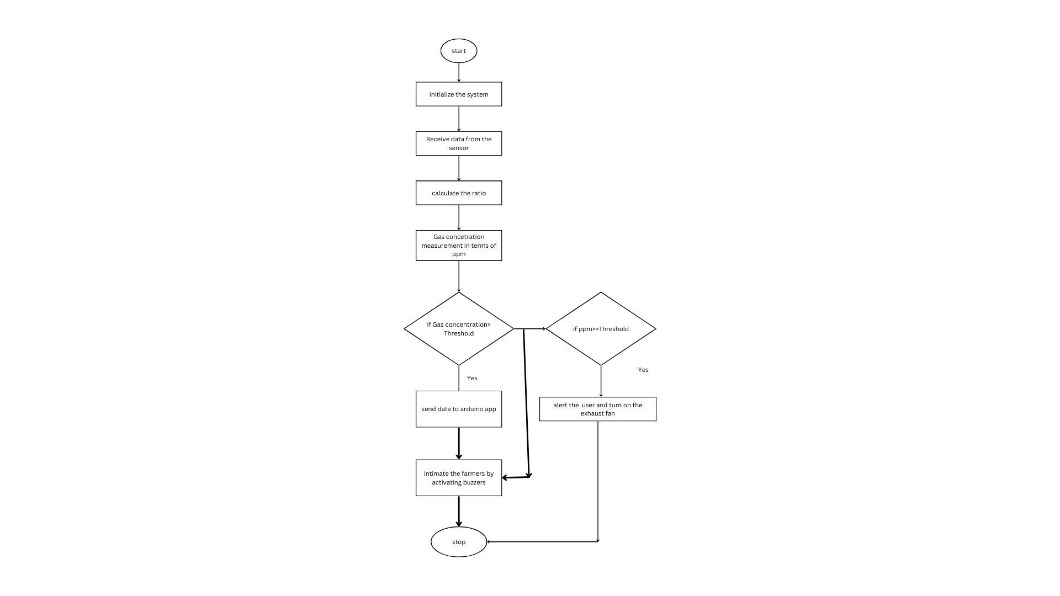
Architectural Diagram

Slide 9
Modules split up
Module 1 : Components used and circuit design
Module 2 : Connecting Components
Module 3 : Testing the Hardware
Module 4 : Integrating with Thinkspeak webserver

Slide 10
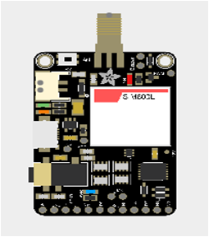
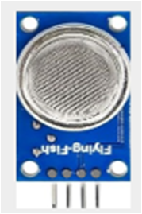
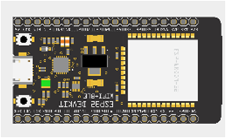
module 1- cOMPONENTS
CONTROLLERS SENSOR
`GSM SIM800C MQ-137
(Ammonia sensor)
Node MCU ESP-32 WROOM

Slide 11
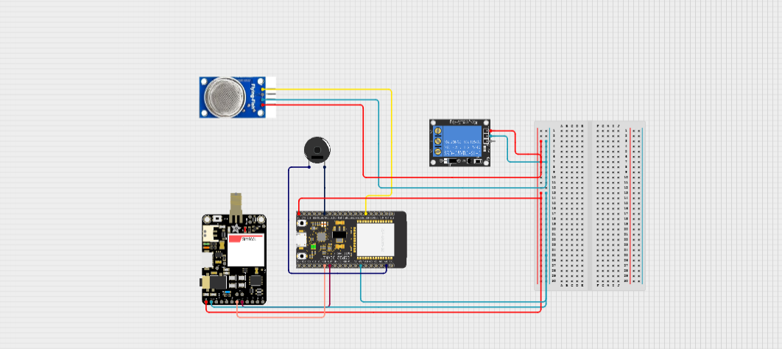
Module 1- CIRCUIT design

Slide 12
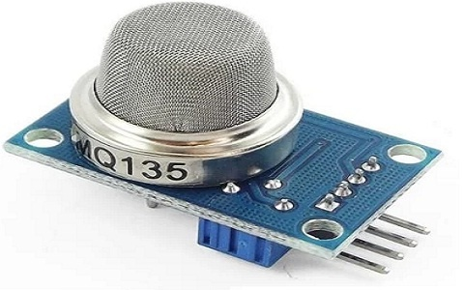
Module 2- SENSOR
MQ-135
An MQ-135 air quality sensor is one type of MQ gas sensor used to detect, measure, and monitor a wide range of gases present in air like ammonia, alcohol, benzene, smoke, carbon dioxide, etc. It operates at a 5V supply with 150mA consumption.
Accuracy: ≥ 3% Reaction time: ≤ 1s

Slide 13
MODULE 3-Blynk
Blynk is a popular platform that allows users to easily build and control Internet of Things (IoT) projects using a simple drag-and-drop interface. It provides a comprehensive suite of tools and services for creating IoT applications, including a mobile app builder, cloud-based infrastructure, and a wide range of supported hardware devices. With Blynk, users can quickly prototype, develop, and deploy IoT solutions without the need for extensive programming knowledge or hardware expertise.

Slide 14
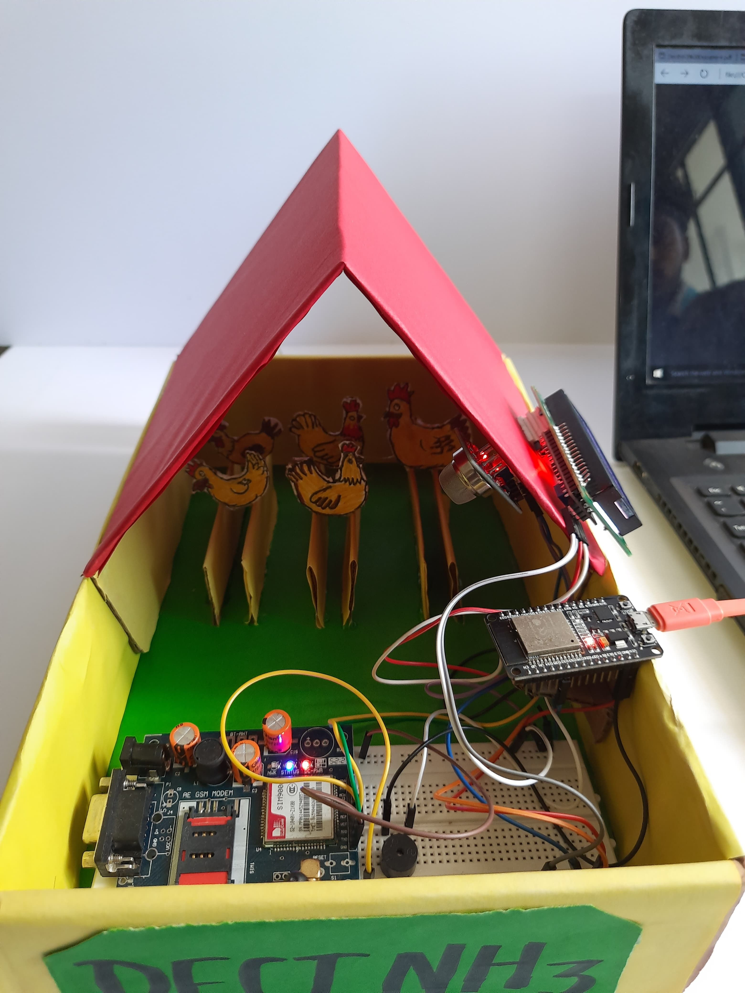
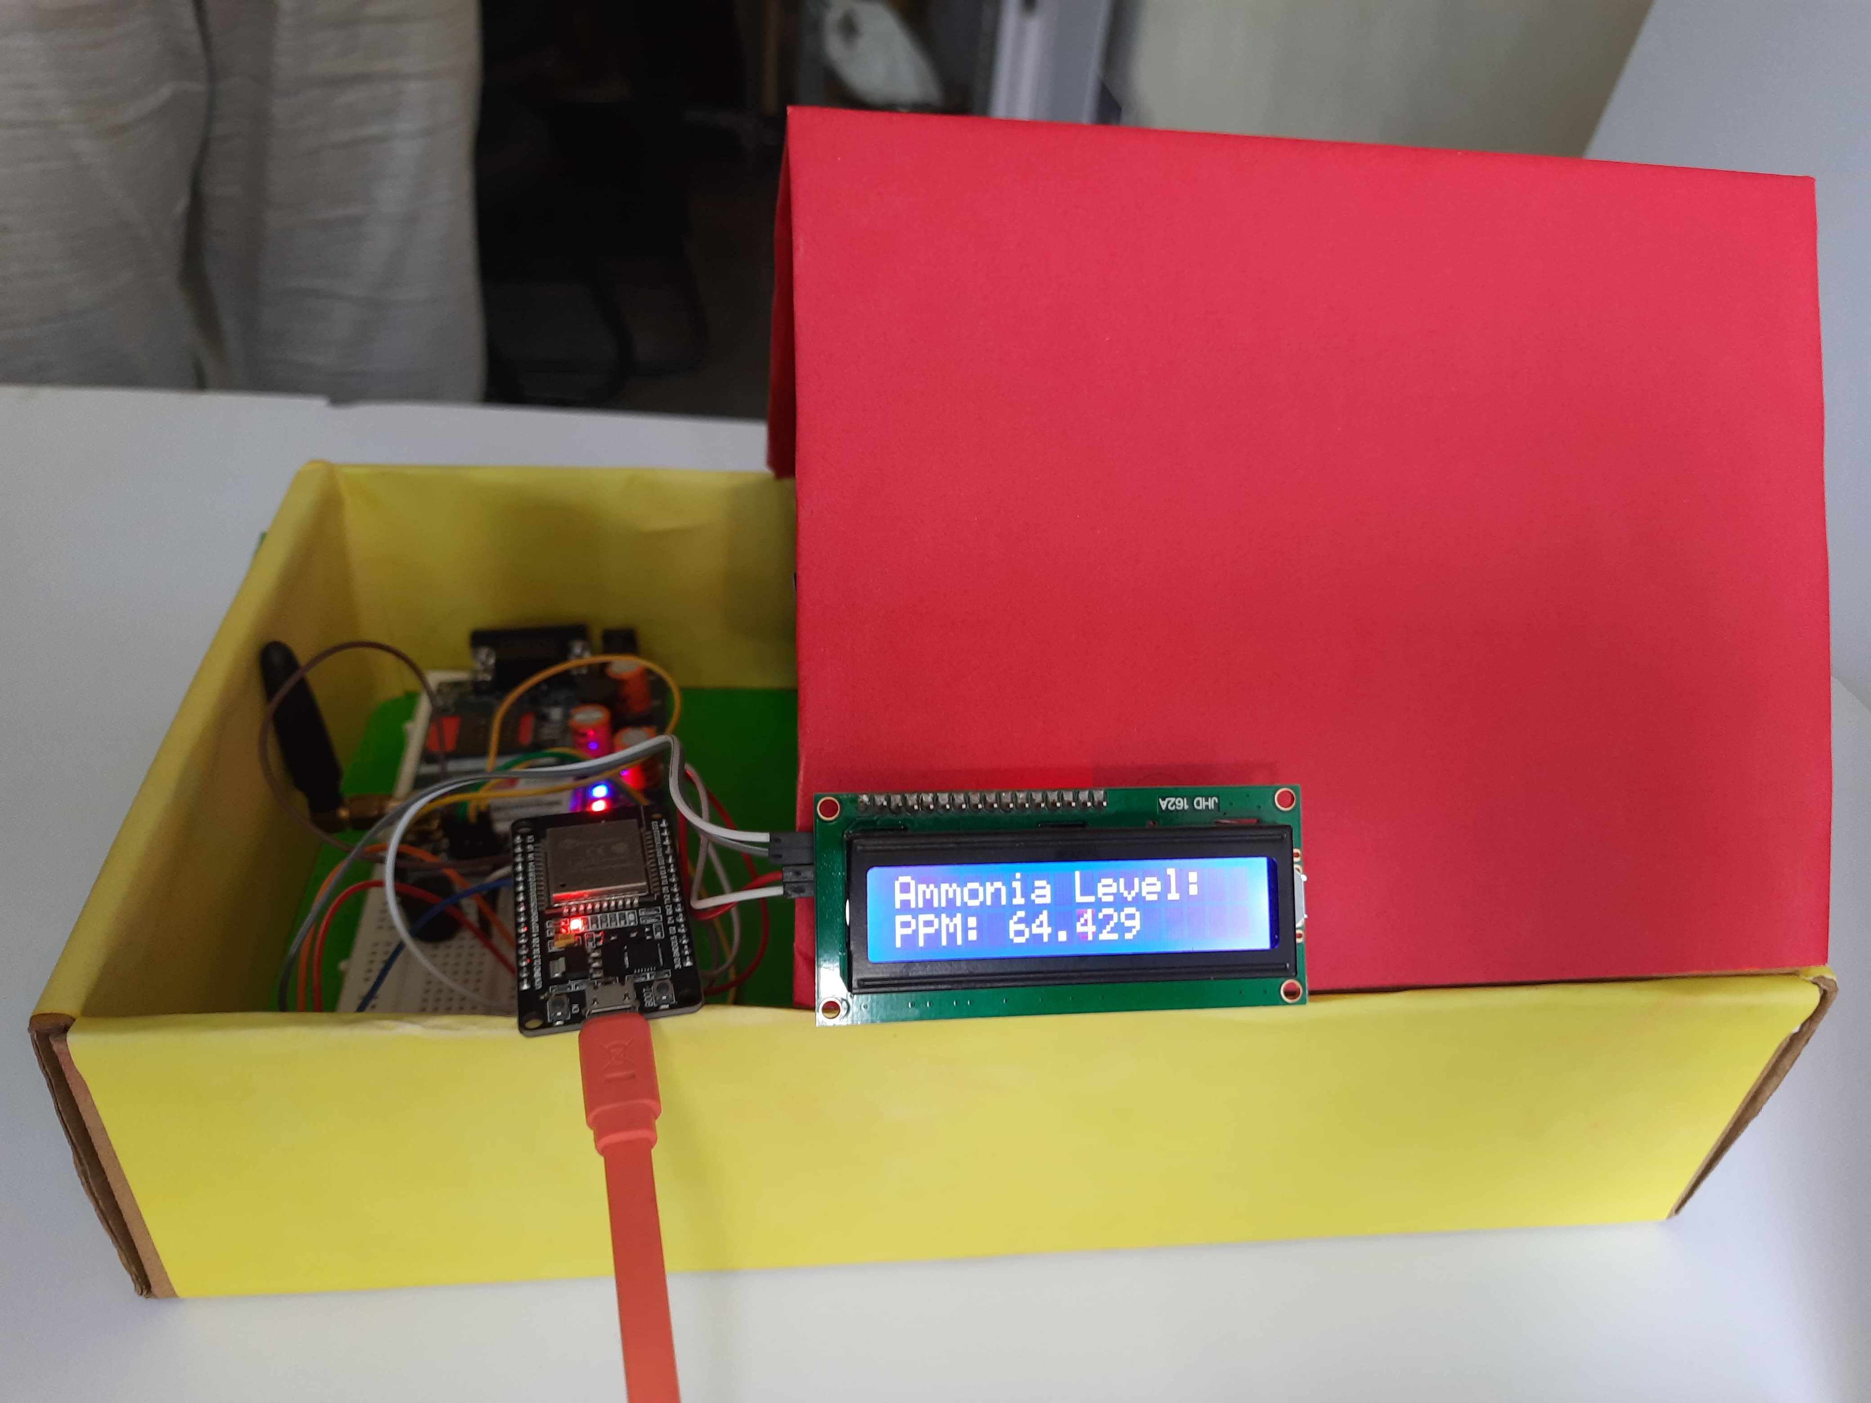
detection of ammonia in poultry farms

Slide 15
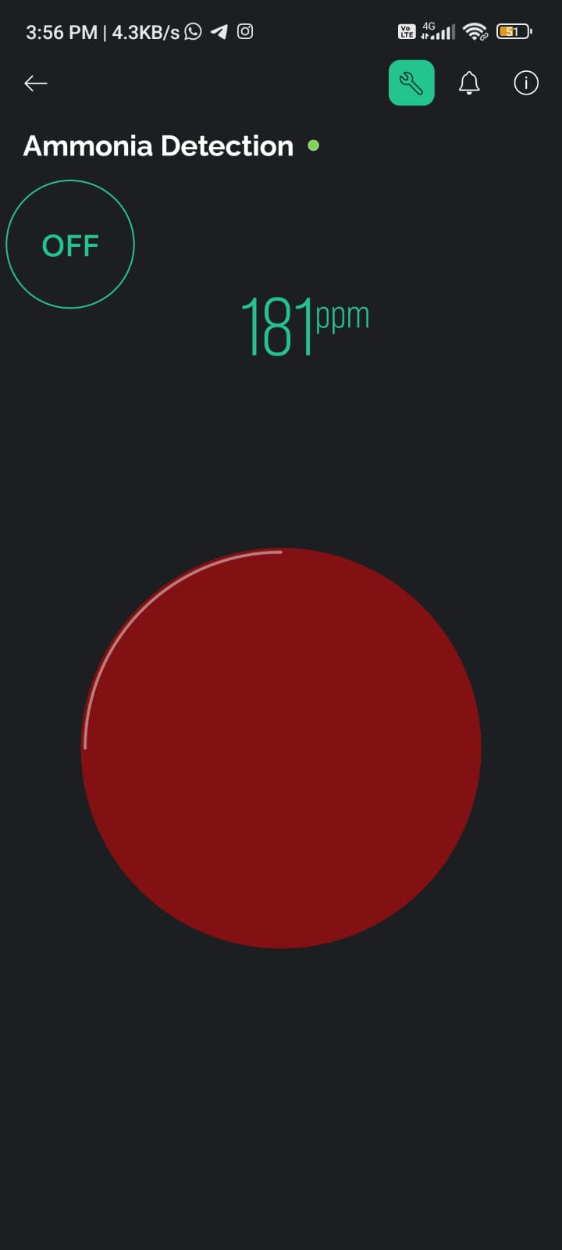
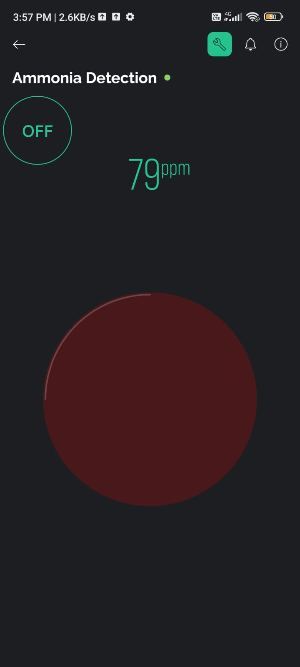
MODULE 4-Detection of ammonia using blynk

Slide 16
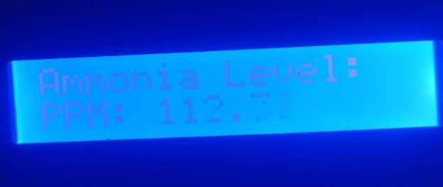
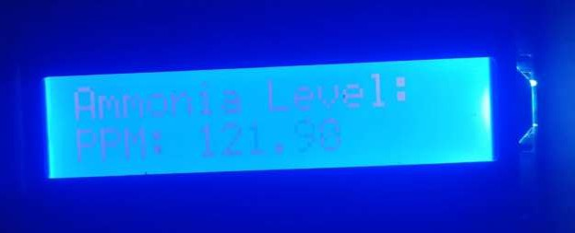
MODULE-5 display output

Slide 17
EXPECTED OUTCOME
This project is a comprehensive and automated system for monitoring and managing gas emissions from bird litter in poultry farming facilities.
By integrating advanced sensor-based technology, real-time data analysis, and proactive alert systems, the project aims to significantly improve air quality, mitigate odor issues, and control fly populations.
The implementation provides managers with timely insights into gas concentrations, enabling them to take prompt and effective measures.
This will enhance operational efficiency and it also seeks to deliver a reliable, scalable solution for monitoring gas emissions in poultry farms, contributing to industry advancements and sustainability.

Slide 18
REFERENCE
[1] "Ion imprinted polymer based electrochemical sensor for environmental monitoring of copper (II)
Authors:Muna A. Abu-Dalo, Abubakar A. Salam
[2] "In situ ammonium profiling using solid-contact ion-selective electrodes in eutrophic lakes“
Authors: Rohini Athavale , Ilga Kokorite
[3] Paper Title: "Graphene electrochemistry: fundamental concepts through to prominent applications"
Authors: Dale A. C. Brownson,Dimitrios K. Kampouris

Slide 19
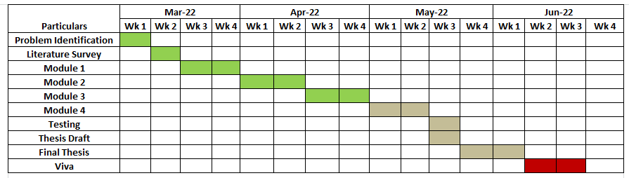
TIMELINE

Slide 20
THANK YOU

